Slide 1
有文字的PPT只是作为提示切换时机的备份，实际上是隐藏的不会播放出来

Slide 2
背景和演戏时台上演员的布局是否一致要再看看，不对的话可以镜像/翻转

Slide 3
Act9的背景实际上不是第一幕的背景，但我摆烂了，不行的话我再换

Slide 4
Act 4.Scene 2 和 Act 7. Scene 2 找不到合适的背景，麻烦帮忙找找

Slide 5
动画和细节之后再调整

Slide 6
音乐除了cheerful那个我都放了（分别在Act1Scene2和Act9），我不太理解cheerful, such as reveille是什么意思

Slide 7
最后的音乐我直接用的cant buy me love，但是稍微编辑了一下有点复古的感觉，不知道是否符合要求

Slide 8
Act 1. Scene 1

Slide 9
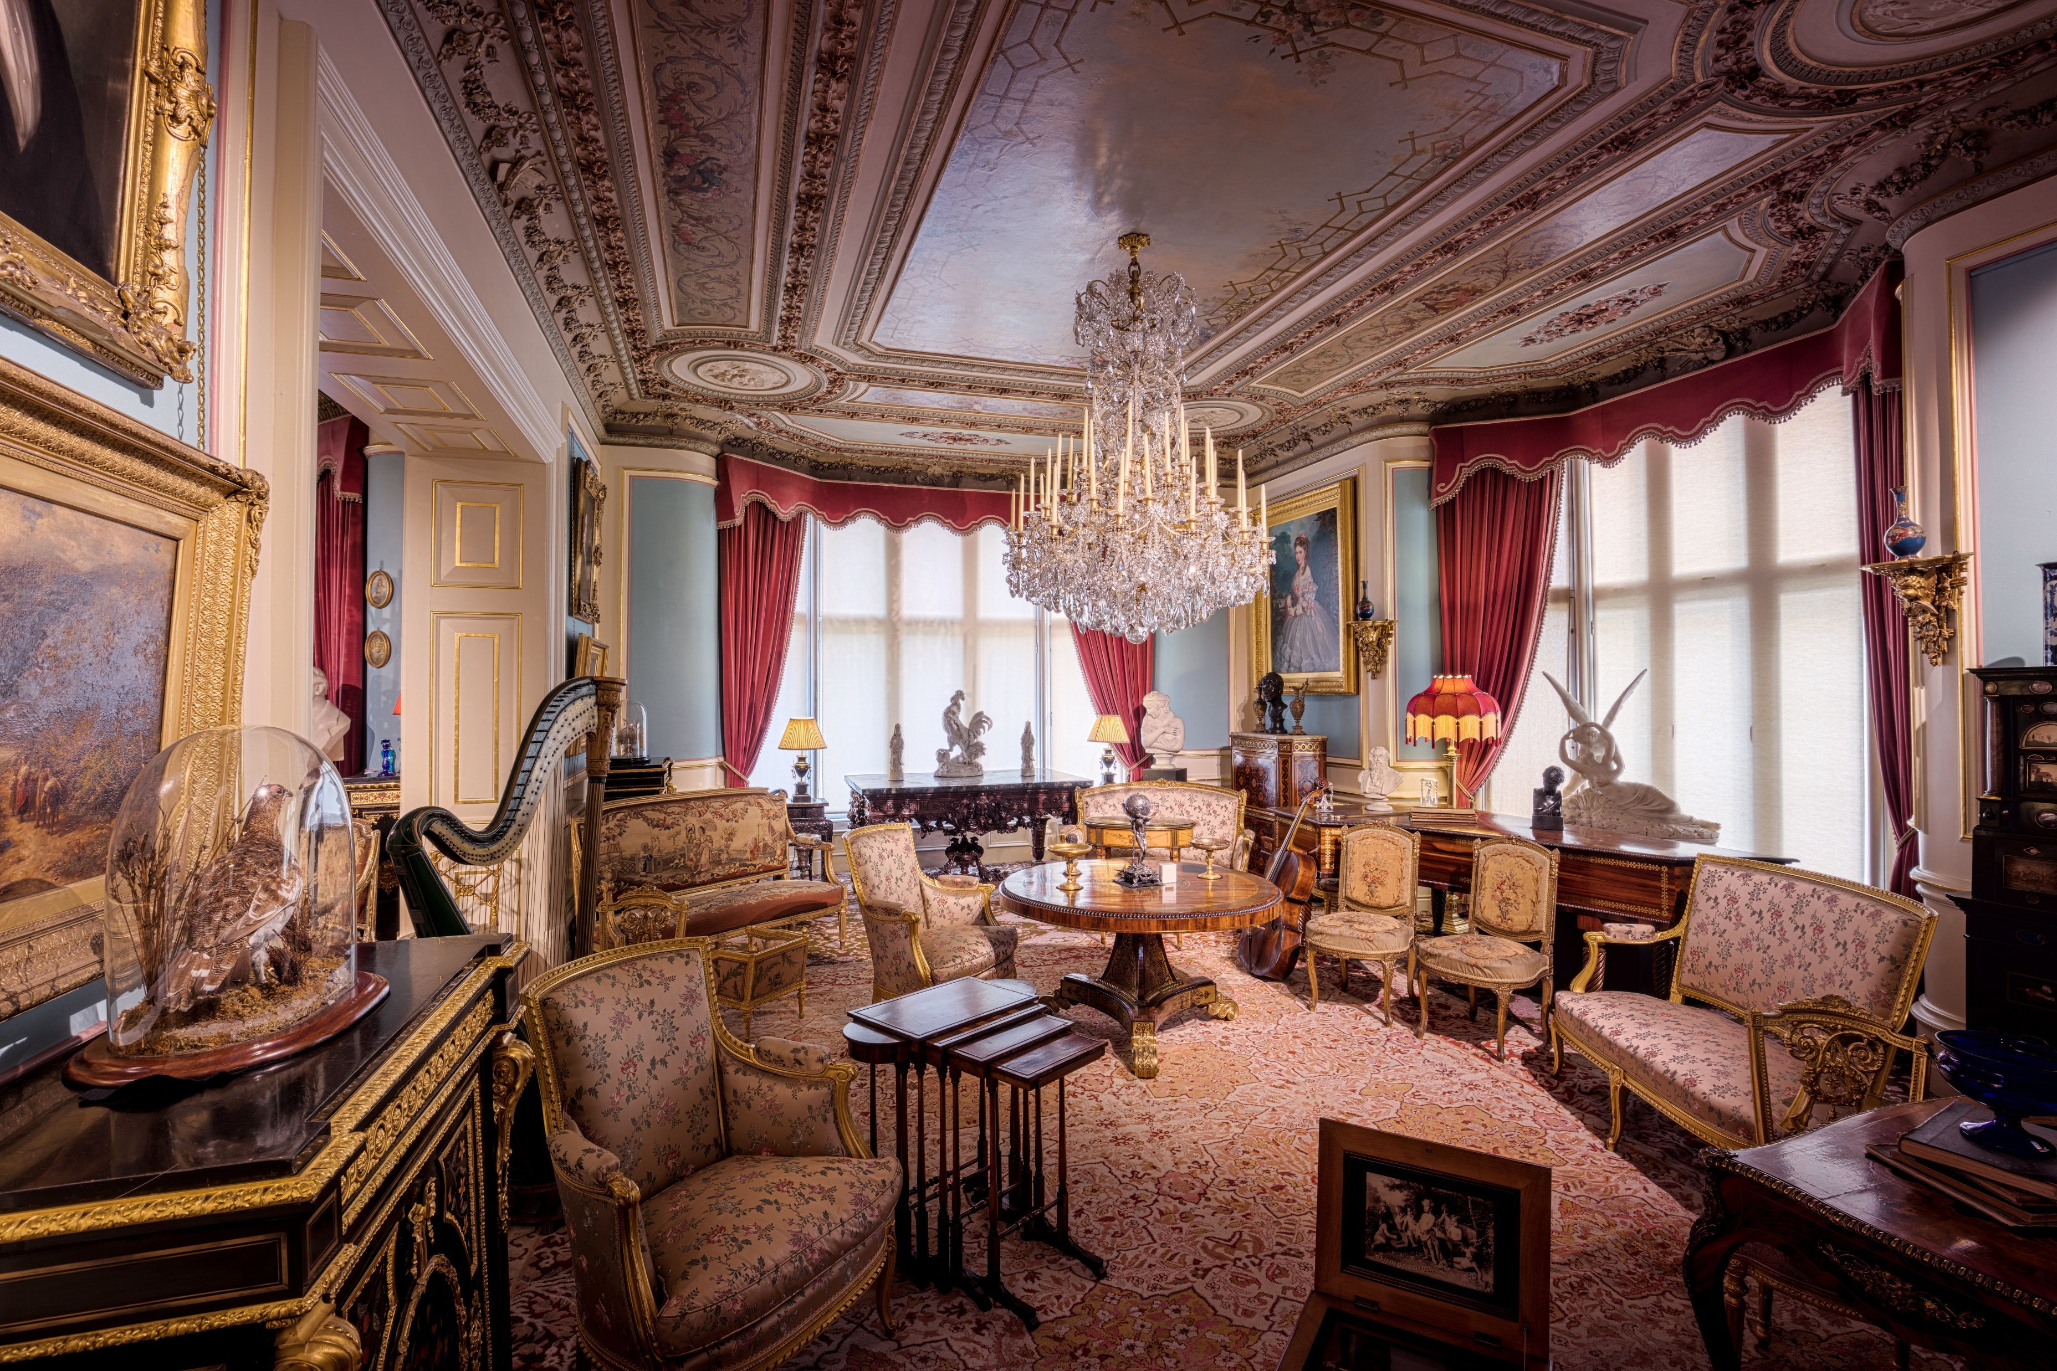
两个老头密谋打赌的场景 找不到合适的☹

Slide 10
Act 1. Scene 2
Last scene ending with:
Mr. G: (frown) A bet? Oh gentlemen, I am astonished at your purpose, and that you should call it ... a scrap of paper. Allow me to draw your attention to the text. (reads, slowly and carefully) I promise to pay the bearer on demand the sum of one million pounds.
(R.M. and O.M. looked at each other, smiled again and nodded without saying a word.)

Slide 11
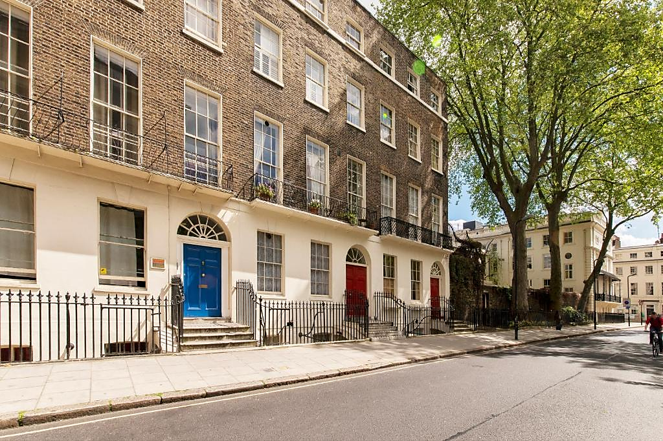

Slide 12

两个老头密谋打赌的场景 找不到合适的☹

Slide 13
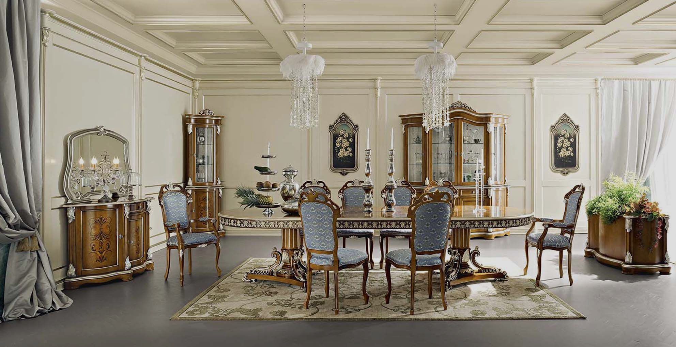
弃用 已隐藏
两个老头密谋打赌的场景 找不到合适的☹

Slide 14
Act 2
Last act ending with:
(O.M. and R.M. standing up too)
R.M.: Mr. Adams! (pause for a while, then with a smile) Wish you good luck.
H.A.: (slightly sighing) Thank you, sir. Goodbye.

Slide 15
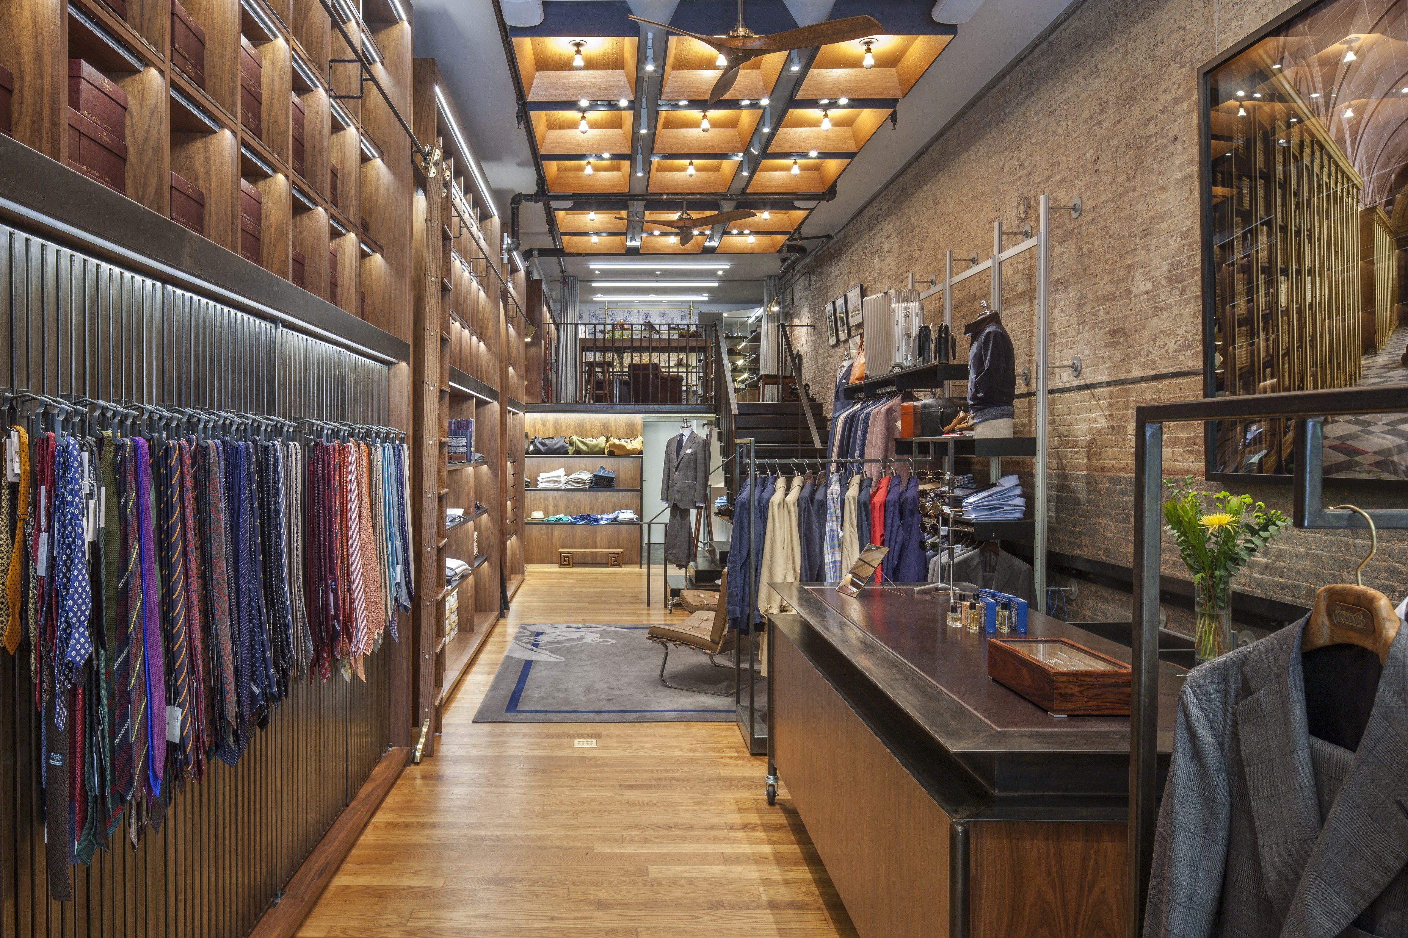

Slide 16
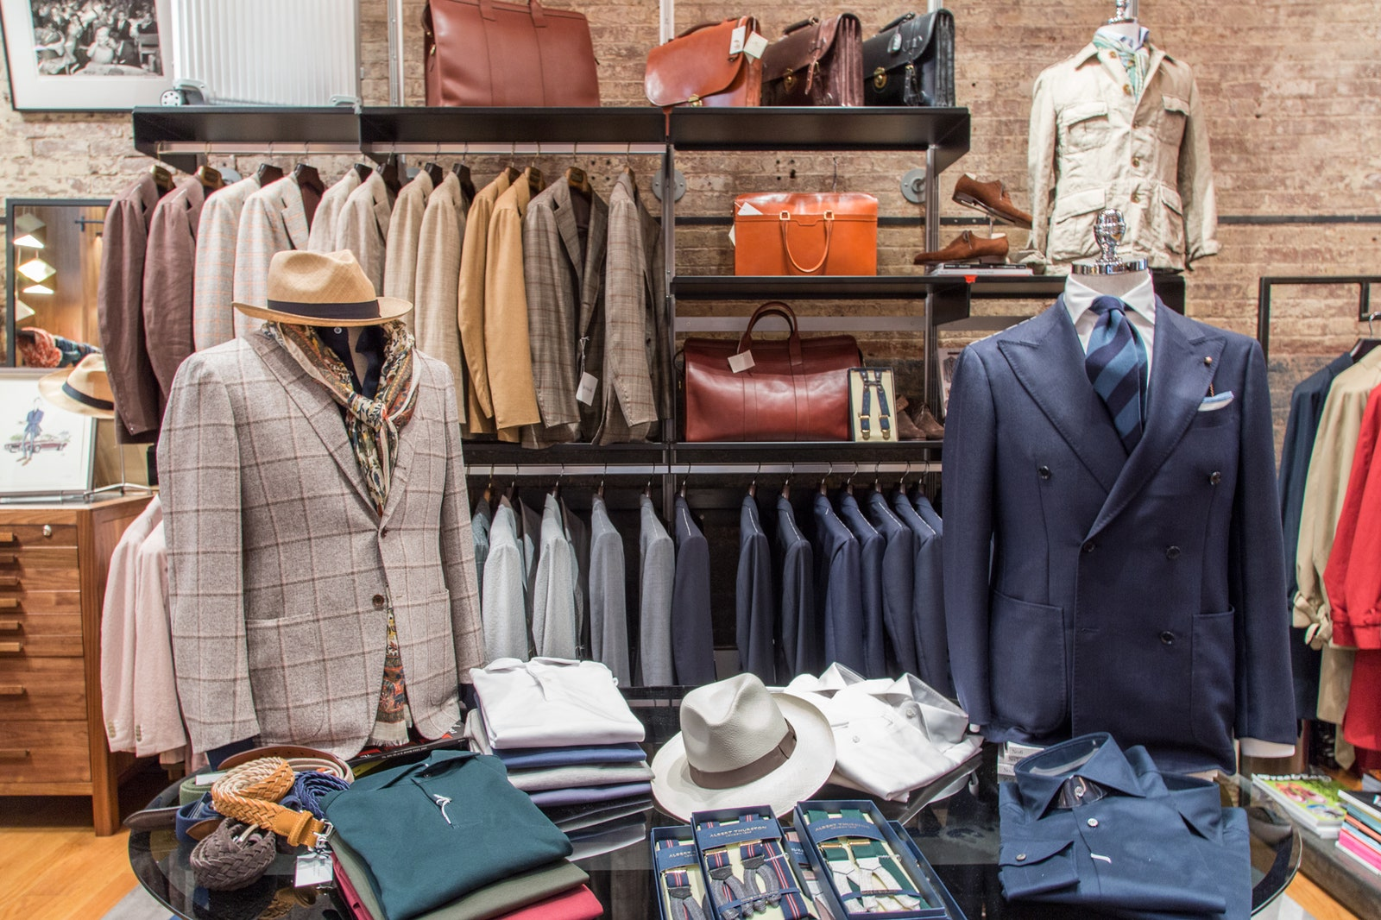

Slide 17
Act 3
Last act ending with:
H.A.: Bumbles?
C.S.M: The very place, quiet, modest and discretion itself. (with a very very sycophantic smile) Luckily for you I have a relative on the management. Leave it to me.

Slide 18
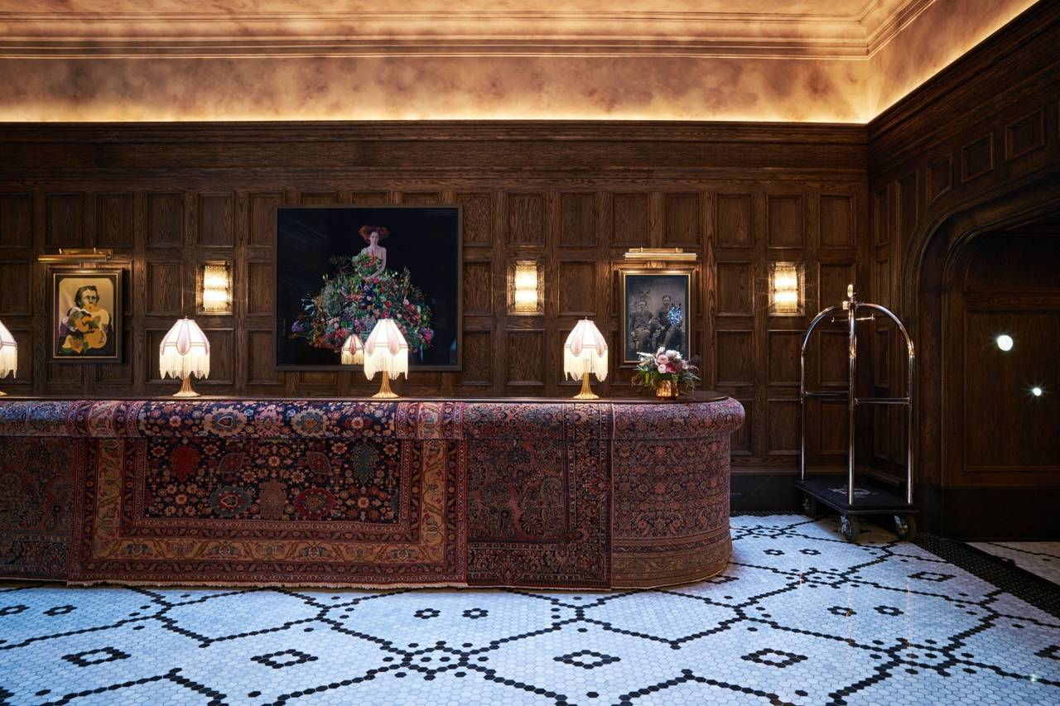

Slide 19
Act 4. Scene 1
Last act ending with:
Rock: (Holds out his hand)
H.A.: (Shakes hands with Rock) (To Rock, proudly) For the next month, I’m H.A., the American Millionaire.

Slide 20
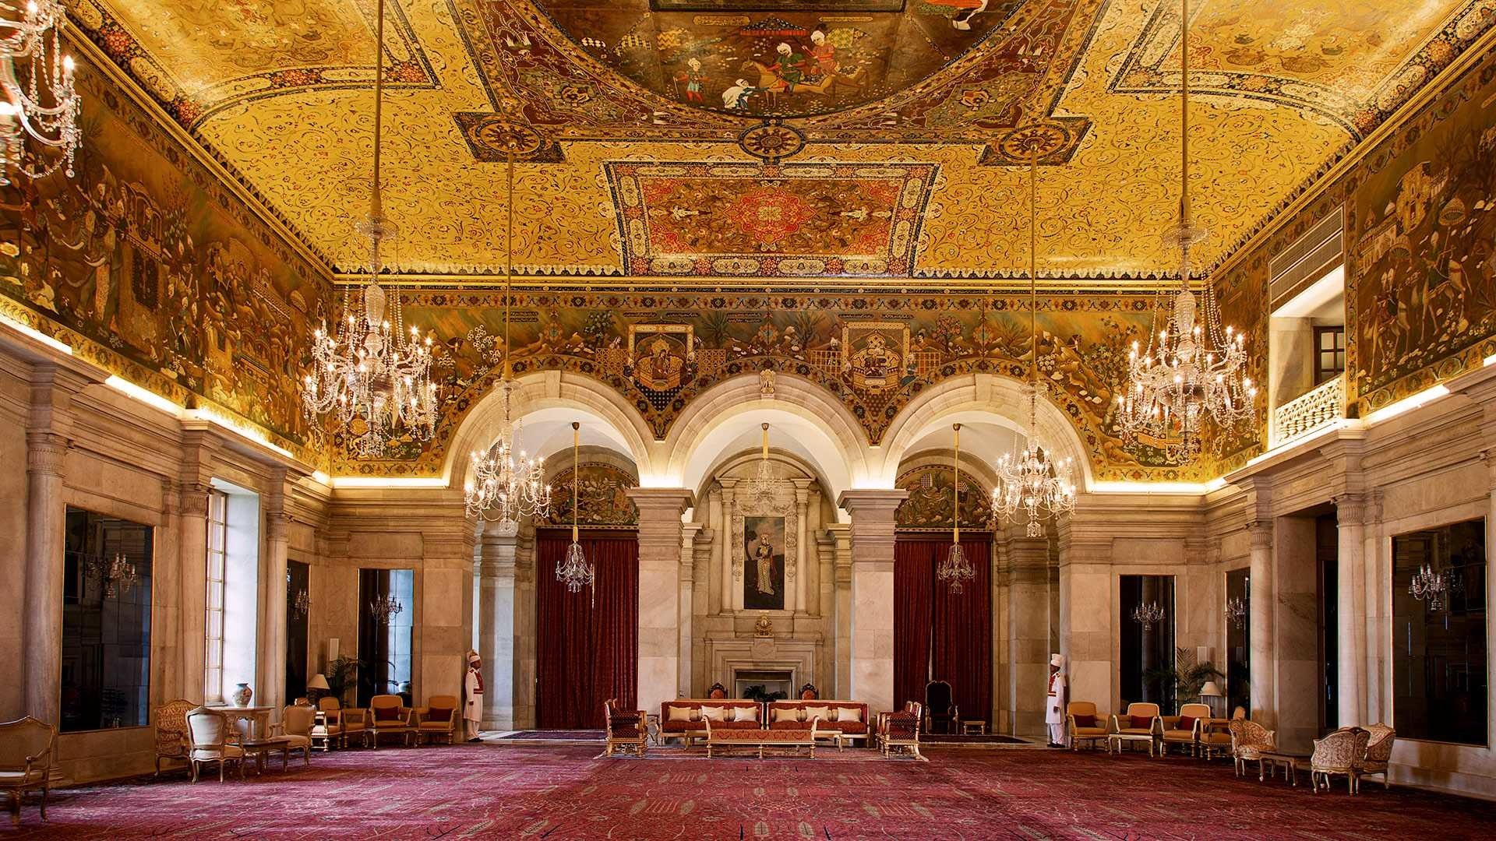

Slide 21
Act 4. Scene 2
Last scene ending with:
Guest 3: Now, Mr. Adams, I want you to make the acquaintance of Sir William Collins...
(H.A. and Guest 3 off the stage)
Guest 1: A man of character!
Guest 2: We must invite him to lunch!

Slide 22
Garden躲雨的场景 找不到合适的☹

Slide 23
Act 5
Last act ending with:
(Henry and P.L. off the stage.)
N.: Henry is invited to the Home for Motherless Babies. After taking a look at the babies, he is taken to a charity auction. He doesn't want to donate much, but is urged by the audience to donate five thousand pounds.

Slide 24
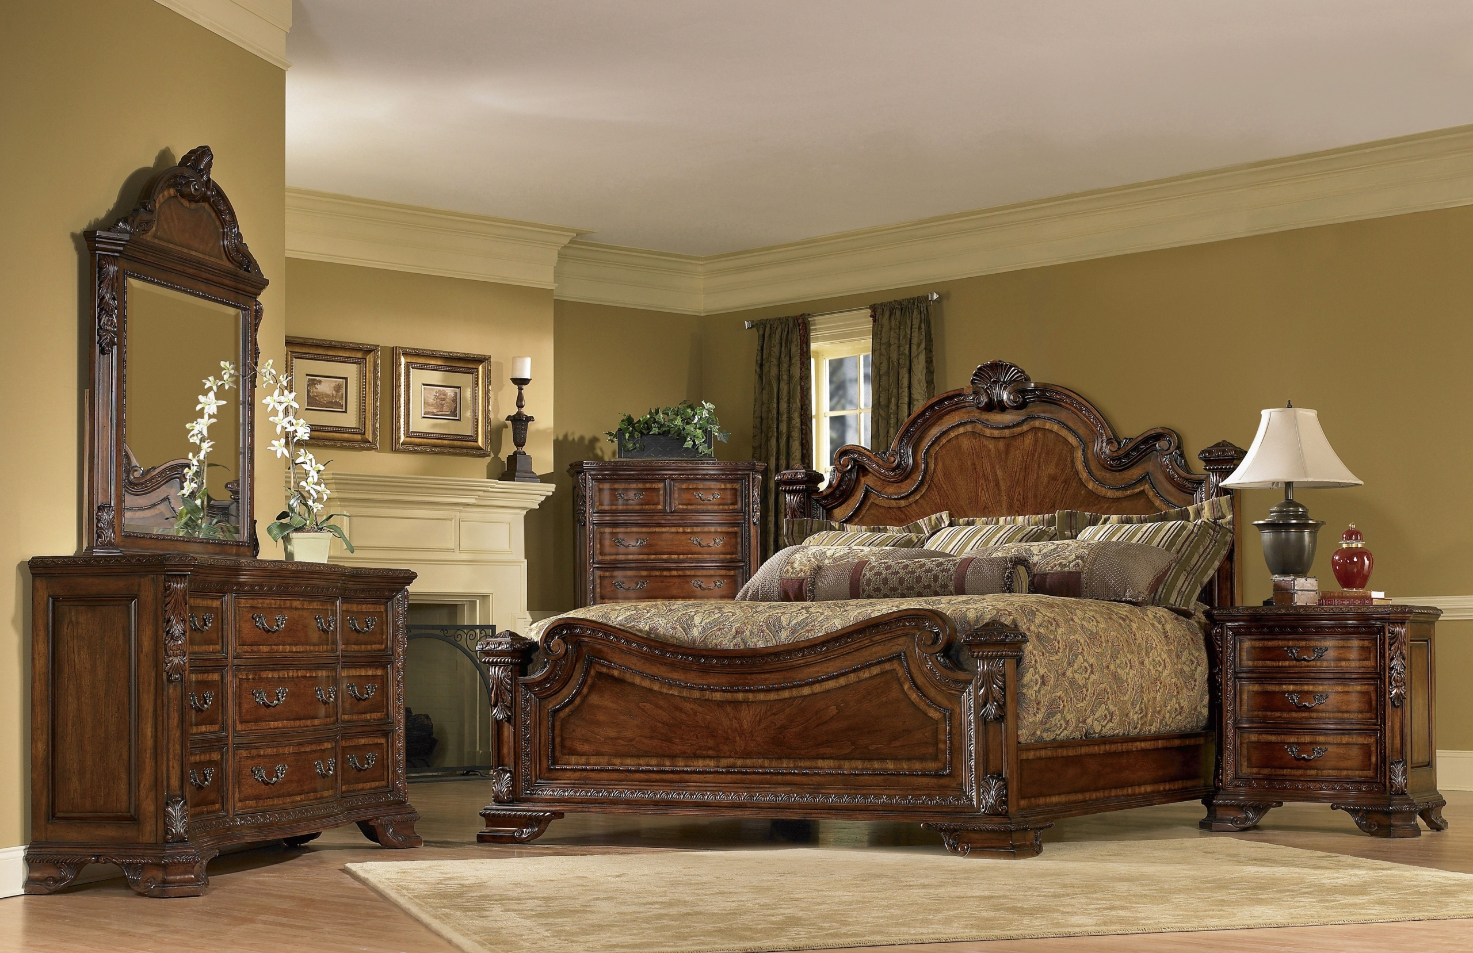

Slide 25
Act 6
Last act ending with:
H.A.: (Cheerfully) Rock! We're not going. (Tapping Rock on the shoulder) Things always look bad at night. But in the morning the sun is shining and the birds are singing. We can't throw in the cards like this when the game is only halfway through.

Slide 26
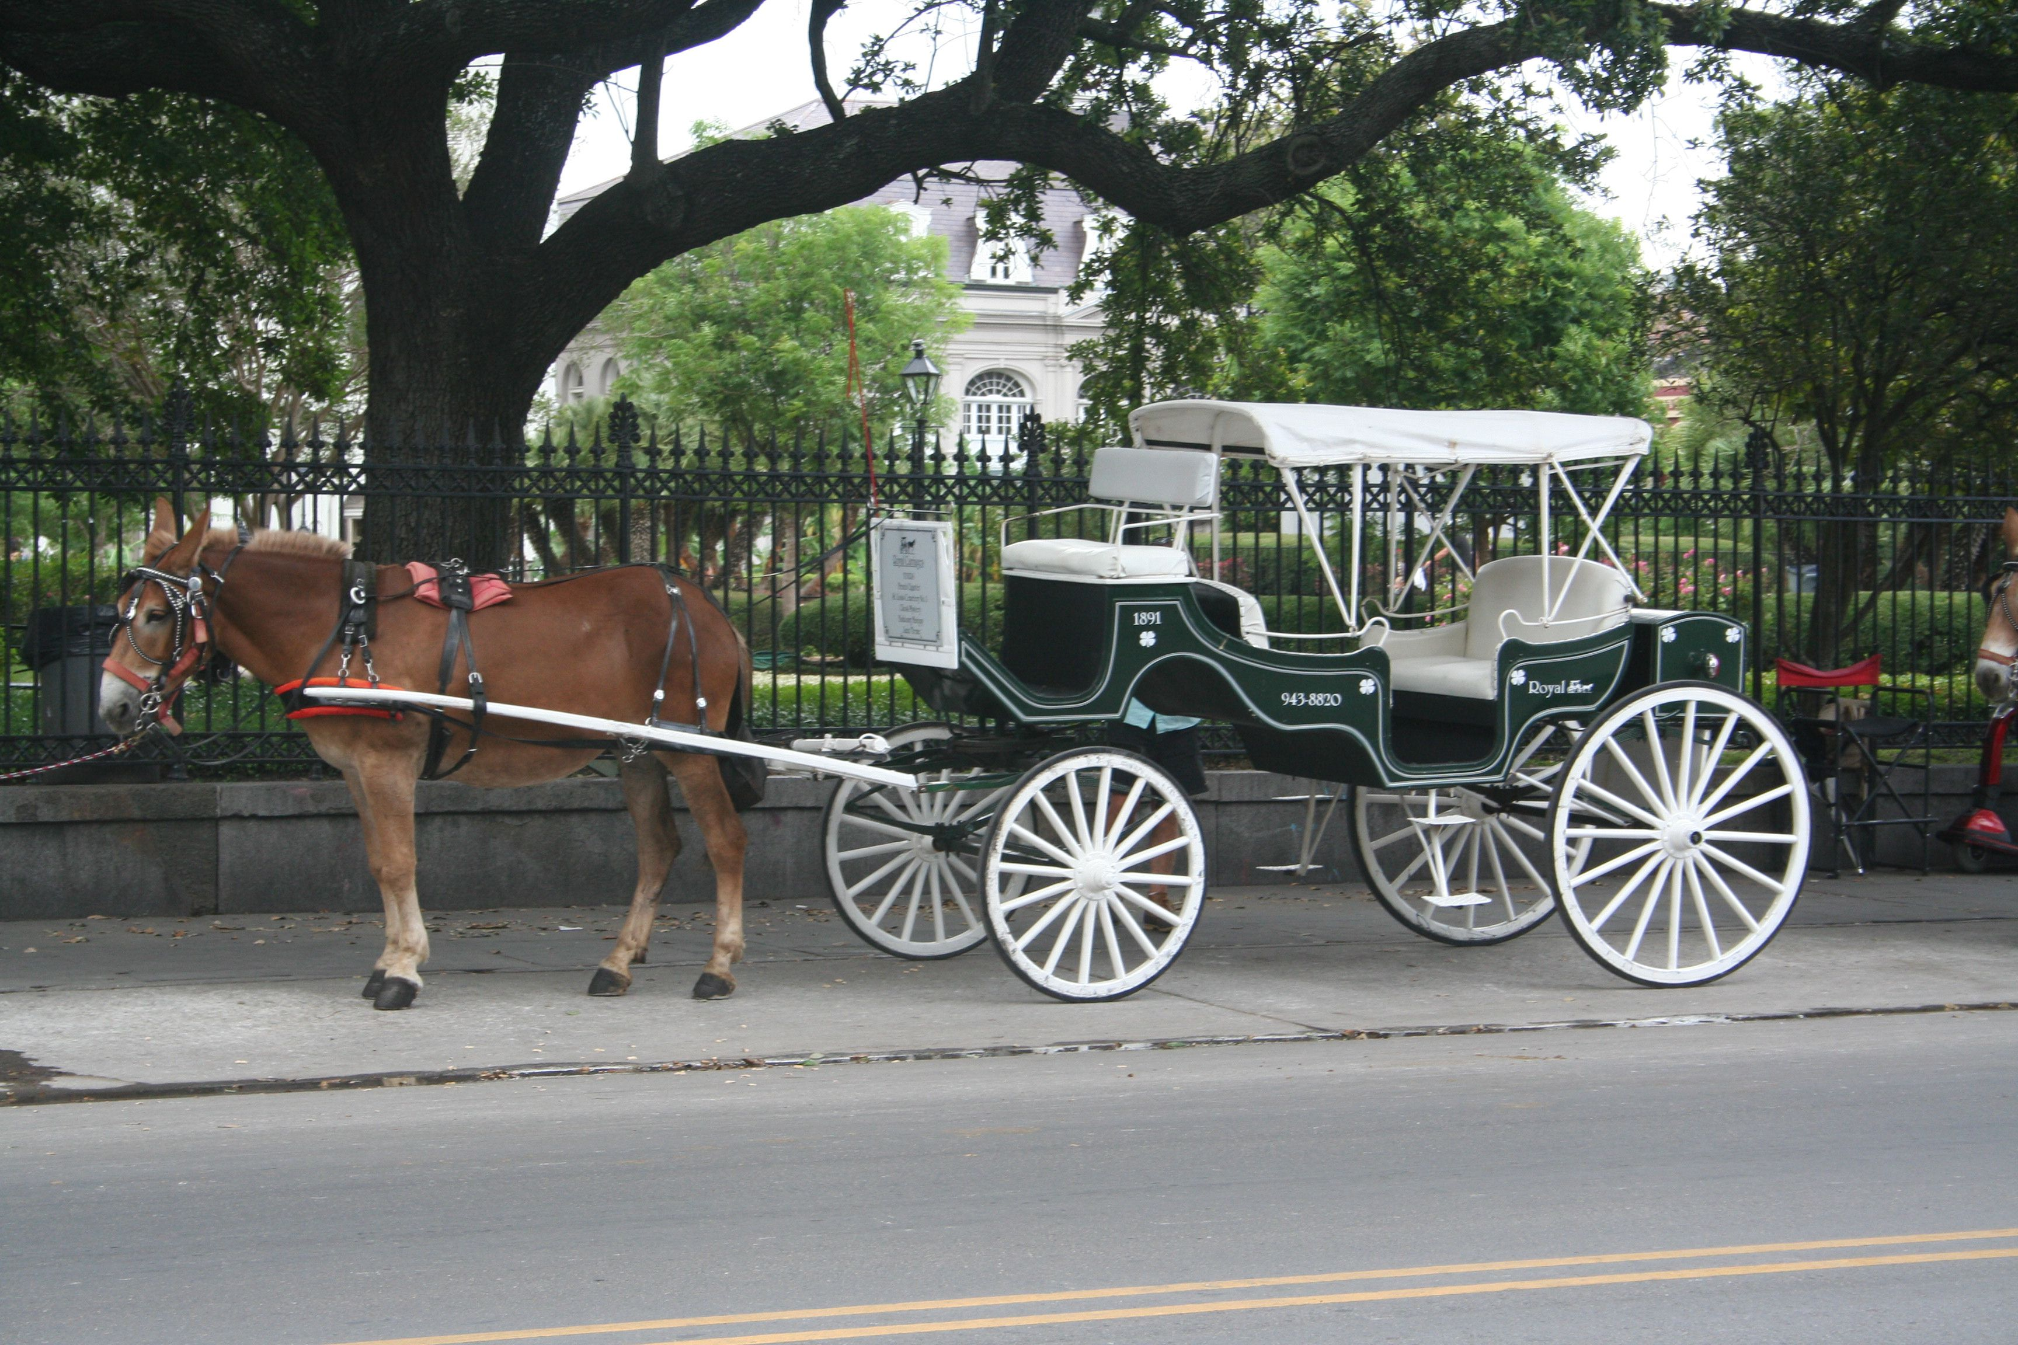

Slide 27
Act 7. Scene 1
Last act ending with:
Mr.H.: (Excitedly) I may use your name! Your name - think of it! Man, they'll flock in droves, these rich Londoners; they'll fight for that stock! I'm a made man, I'm a made man forever, and I'll never forget you as long as I live!

Slide 29
Act 7. Scene 2
Last scene ending with:
M.bum: He's a public figure, your grace, of considerable standing.
D.F.: Stuff and nonsense! (irritated, angrily leaves the counter without even picking up the bank notes)

Slide 30
密谋藏note的maids pantry场景 也找不到合适的☹

Slide 31
Act 7. Scene 3
Last scene ending with:
N.: (Renie.Bum acts correspondingly) And so Renie gracefully strode into Henry's suite with the subterfuge of a cleanup. Smartly lurking behind Henry's views, she adeptly took the cheque out of Henry's clothes in the wardrobe and hid it right beneath the carpet - just like a skillful prowler. Poor Rock didn't even took notice of Renie's presence.
(Renie.Bum returned to Duke of Frognal who feigned a praise and left)

Slide 32
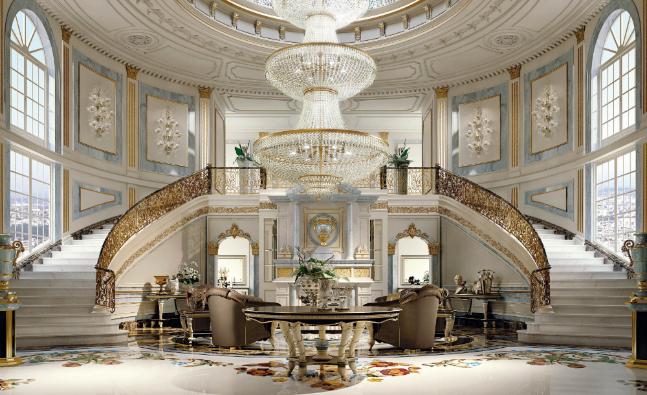

Slide 33
Act 7. Scene 4
Last scene ending with:
Duchess.C.: No, my dear. If you were an ordinary girl it wouldn't matter. But, alas, we are not an ordinary family.
(Aunt locks the door, with P.L. desperately pounding from inside)
P.L. Let me out!

Slide 34
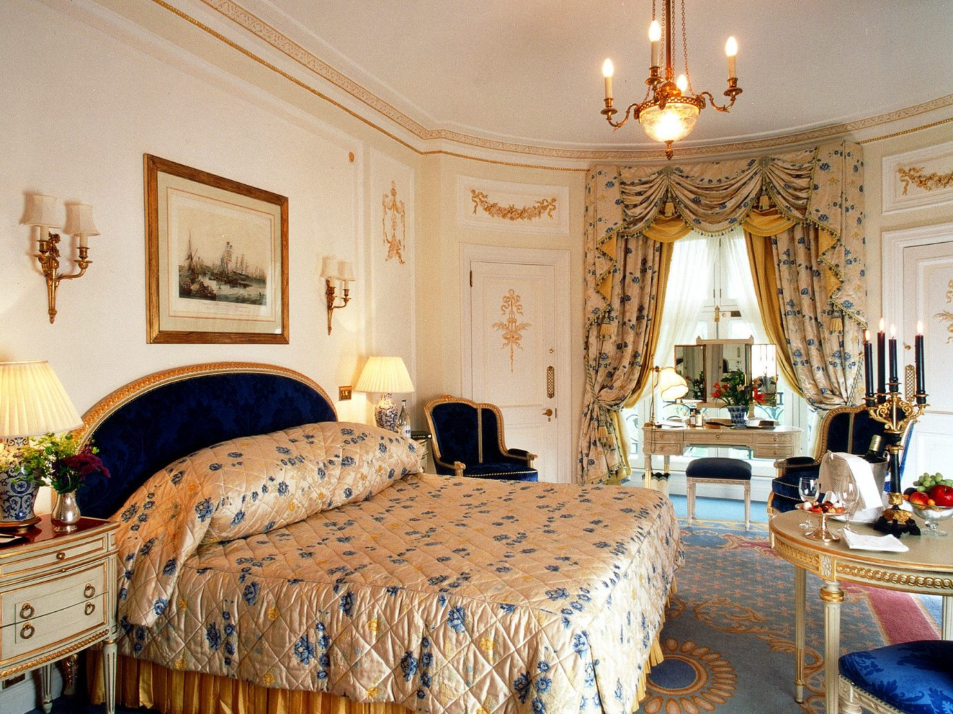

Slide 35
Act 7. Scene 5
Last scene ending with:
H.A.: (pensive, but then delighted when he reminisced of Hastings' shares) I'll settle my accounts in full this aternoon. It so happens that my real fortune is tied up in mining ... gold mining. Well, good morning, gentlemen. You're a fascinating species. Sometime you must take a good look at yourselves (hurry out the doorway, arrogant) ... under a microscope.

Slide 36
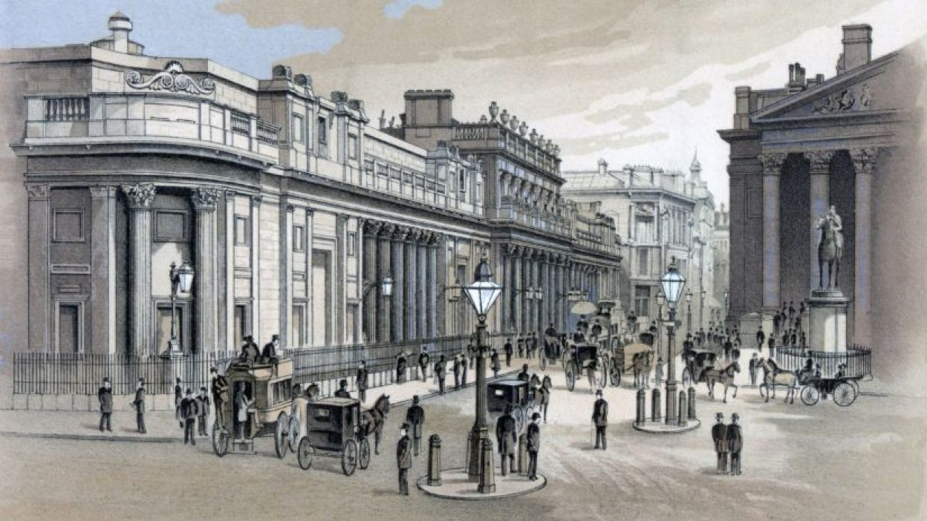
London Stock Exchange

Slide 37
Act 8
Last act ending with:
H.A.: (pensive, but then delighted when he reminisced of Hastings' shares) I'll settle my accounts in full this afternoon. It so happens that my real fortune is tied up in mining ... gold mining. Well, good morning, gentlemen. You're a fascinating species. Sometime you must take a good look at yourselves (hurry out the doorway, arrogant) ... under a microscope.

Slide 39
Act 9
Last act ending with:
N.: Remember our Portia? Well, as soon as the million pound note was found, the shares price of Good Hope mines peaked again, and Portia's aunt was quite content to receive the five thousand pounds that Henry has promised her. Busy counting money and boasting about her blueprint for the money, Portia's aunt definitely Portia to continue her relationship with Henry. But Portia never cared about those filthy bits of paper - she just badly wanted to see Henry.
(P.L. was escorted into the hall)
P.L. Henry! Oh, Henry.
(Without further words, the two hugged and kissed)

Slide 40
两个老头密谋打赌的场景 找不到合适的☹

Slide 41
弃用 已隐藏

